Slide 1


Open Source Lab
We do Awesome Things!

Slide 2

Who are we?
Notes:
> Community of Students and Teachers
> Enthusiasts who promote Open Source Technologies
> Learning done by Contribution
> Socializing with Co-Enthusiasts on same path
> A part of a huge global network of developers

Slide 3
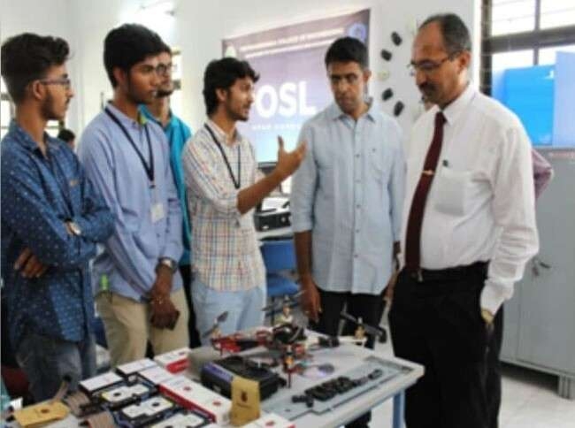
The club’s story started in March of 2017 when the fourth semester students from the Department of Computer Science - Madhurish Katta, Harsha Srinivas, Rahul Ravindra and Pavan Kirigeri came together to build an open source IoT project called ‘Remote Display’.
Open Source Lab was founded due to the lack of opportunities available for students to work on Open Source Technologies. It was set up so that it could emphasize the importance of Open Source in the IT industries and encourage the students to accelerate the growth of the lab by contributing to innovative projects.

Slide 4

What do we do?
Notes:
> Learn latest trending technologies
> Build industry ready projects
> Conduct resourceful workshops
> Host and participate in Competitions around the country
> Attend conferences worldwide to gain exposure
> Provide mentorship and support

Slide 5
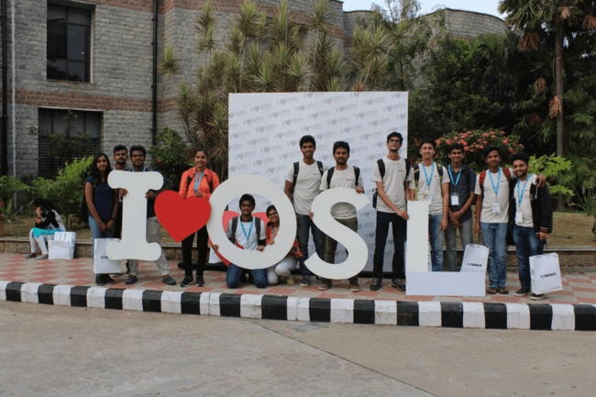
Open Source India Conference

Slide 6
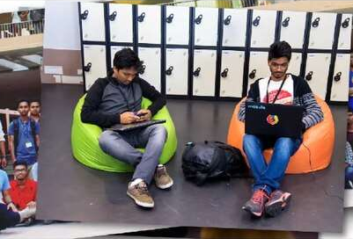
Mozfest

Slide 7
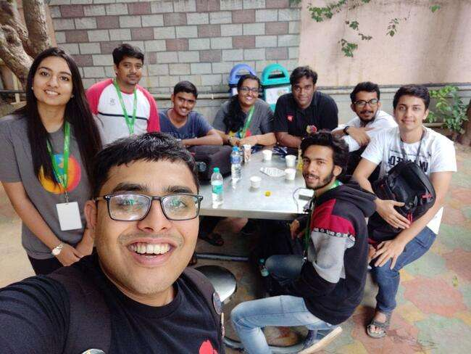
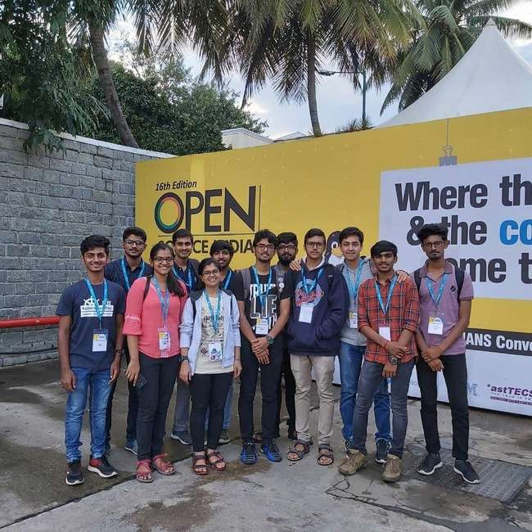
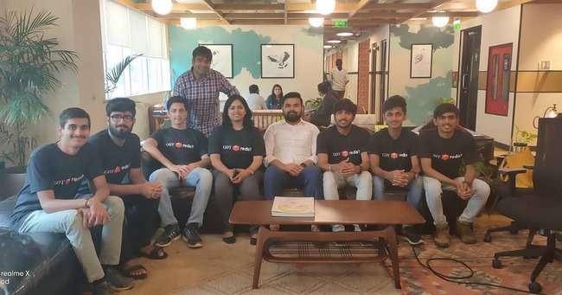
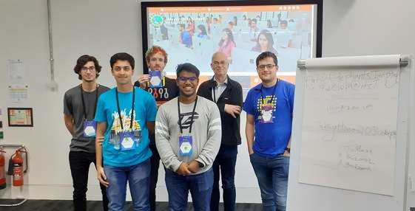
Devconf
Open Source India
Redis meetup
Mozfest

Slide 8

Achievements
Notes:
Open Source Lab has aspired the enthusiasts to participate in competitions, hackathons conducted along the length and breadth of the country. We also participate in conferences held in India and across the world like Open Source India, Mozfest to name a few.
> Motivation to compete in national level Hackathons (example: Smart India Hackathon)
> Attend national & International Conferences ( example: Open Source India, Mozfest)

Slide 9
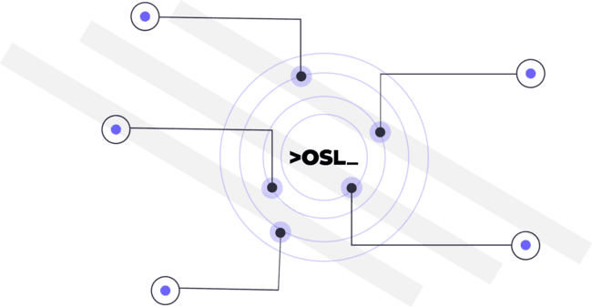
Smart India
Hackathon 2019
One winning team
Three finalist teams
Infosys SOI- 2020
Runners
Silicon Road Hackathon 2018
Finalists
Google Summer of Code 2019
Accepted participant under Mozilla and Xiph
Google Summer of Code 2020
Accepted participant under Gentoo
Major League Hacking Local Hack Day 2018
Winner - Web track
Presented at Mozfest
2018,2019
TiE PitchFest 2020
Runners
Notes:
2k18-19:
> Smart India Hackathon (SIH) :
National level Hackathon
3 Teams selected for finals
1 team won finals
> Silicon Road Hackathon
Conducted for students from Banglore-Mysore
Team made it to Finals
> Miniprojects
Helps working on projects for department
Team won in years 2018 & 2019
2019 - Shreevari SP, accepted GSoC candidate under Mozilla an Xiph foundation working on video technology
2020 - Ashwin, accepted GSoC candidate under Gentoo
2k20-21:
>TiE PitchFest: (Nithin Jaikar, Sourabha G, Ashwin)
Start-up Idea pitching contest; Received mentorship from industry experts to design business models, product pricing and to launch a product.
Team made it to finals [400 teams >> 15 teams (semi finals) >> 5teams (finals)]
>Infosys Summer of Ideas (Sourabha G)
3 month long Ideathon with mentorship from Infosys; worked on innovative ideas to help farmers.
Team made it to Finals [ 150 teams >> 25 teams (semi finals) >> 3 teams (finals)]

Slide 10
Google Summer of Code 2021
3 Accepted Students, 2 completed students
Nsl Hub Internships 2021
7 students
Associate Android Developer
1 certified student
Nutanix Ltd
Gaurav purswani
27 LPA
Back-end Engineer
Google Summer of Code 2022
2 Members
Penetration Test of College Infrastructure
Jan-Feb 2021
Google Cloud Associate
1 certified student
SandLogic Internships 2021
2 students
Notes:
> Google Summer of Code:
3 students accepted - Gaurav Purswani, under Metasploit; Sourabha G, under SugarLabs; Nithin Jaikar, under CRIU
2 Students completed the program (Gaurav Purswani, Sourabha G)
Global open source program; around 1200 students get selected every year; stipend 1500USD;
> A-star internship
> Google Cloud Associate - Nidhi,
Helps working on projects for department
Team won in years 2018 & 2019
>One accepted GSoC candidate under Mozilla an Xiph foundation working on video technology

Slide 11
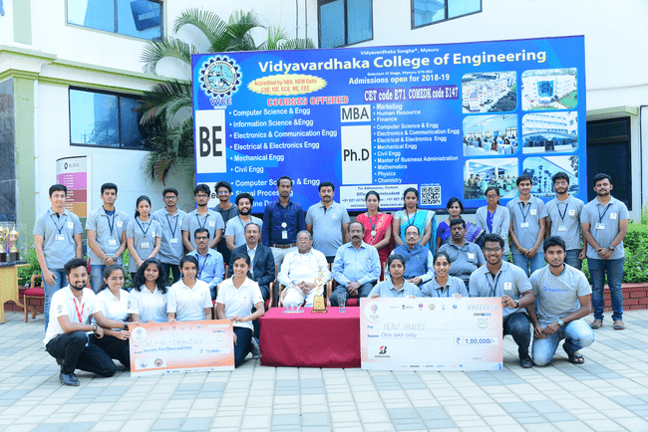
Smart India Hackathon

Slide 12
Events 2021-22
TiE PitchFest
iNeuron.ai
Open Hack Sprint
Open Source Day
SIH
KPMG Ideation challenge
OSL Induction
CS/IS/ME
Hack OnLoad
Capture The Flags
Make Your Mark
Reporting System
Event Report System(GoK)
Hacktoberfest
GSoC Sessions
Build For Digital India
OSI Conference
CodeWars
E-Yantra
Notes:
> Overview:
> Hackathons - National level
> > International conferences
> > Conduct workshops
> > Contribute to open source projects.
Description:
Induction - Hands-on workshop for Freshers
TiE PitchFest -
SIH - Smart India Hackathon - World’s largest Hackathon - By Innovation cell of Ministry of Human Resources and Development
DevConf - Attended Developer Conference by RedHat India and built network
Hacktoberfest - Month long open source contribution sprint and 20 mini workshops conducted
OSI Conference - Open Source India Conference - Promoted Thinger IO development platform(Spanish company product)
WebVR Workshop - Mozilla A-Frame workshop by International speaker
GSoC - Google Summer of Code 2019 - Worldwide open source contribution programme by Google

Slide 13
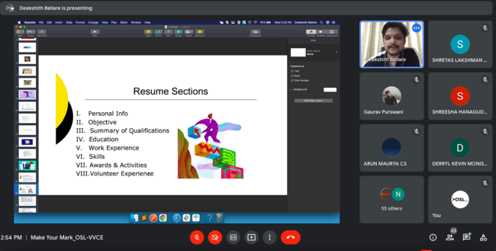
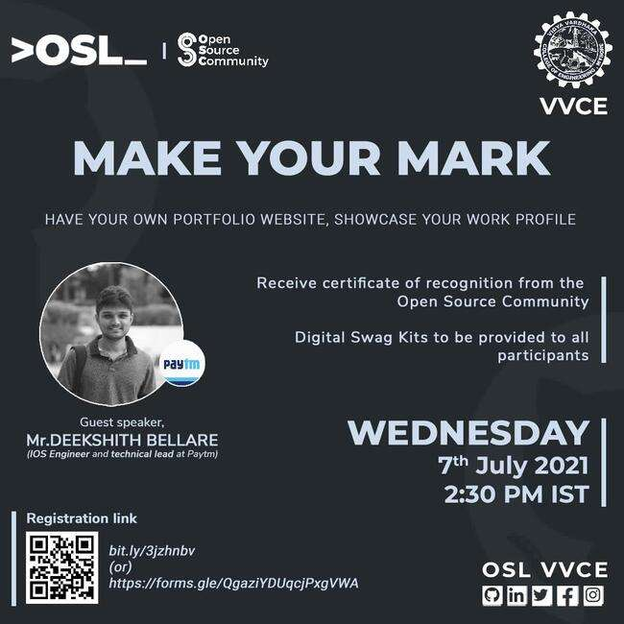
Make Your Mark - Talk and hands-on session on Resume and Portfolio building

Slide 14
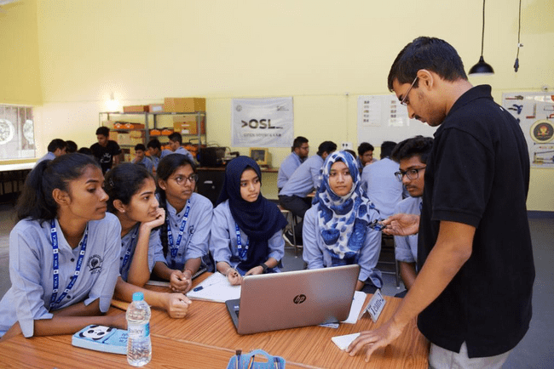
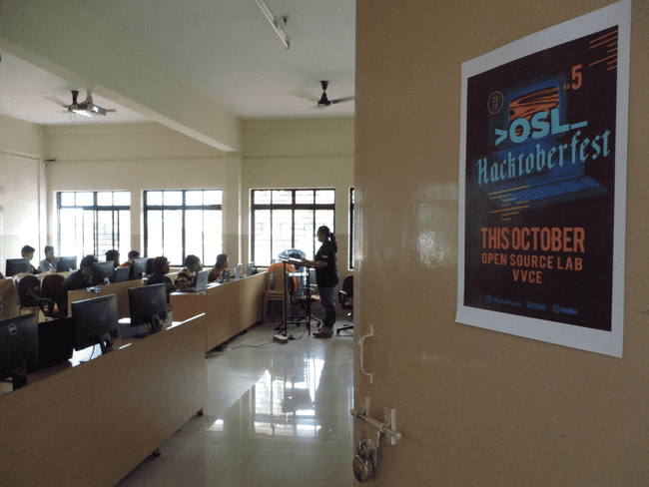
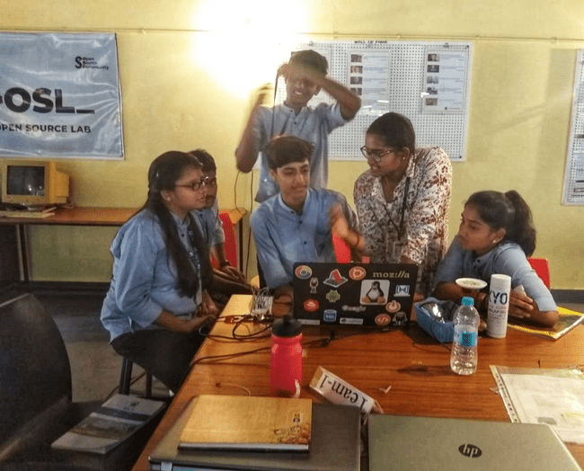
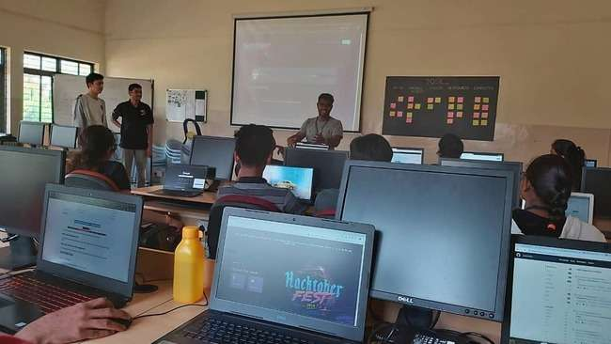
IOT Workshop
Hacktoberfest

Slide 15
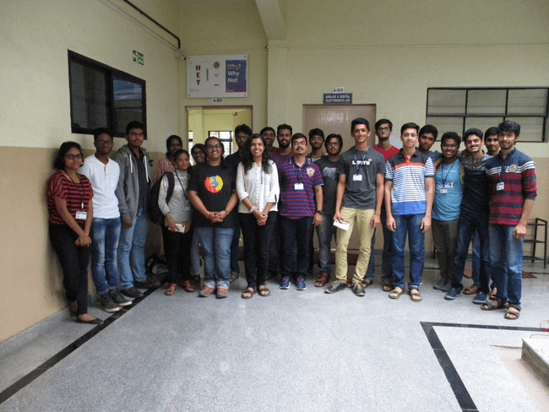
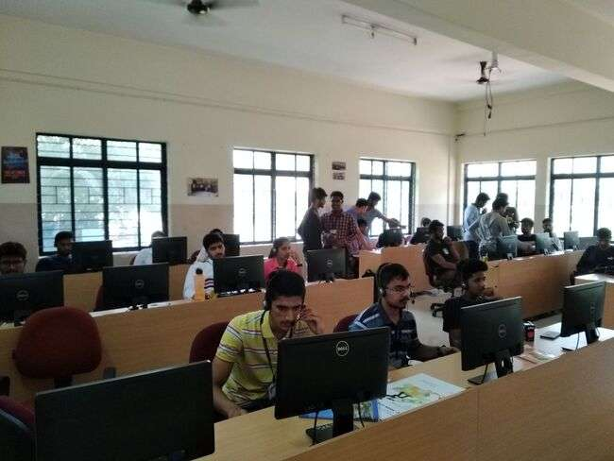
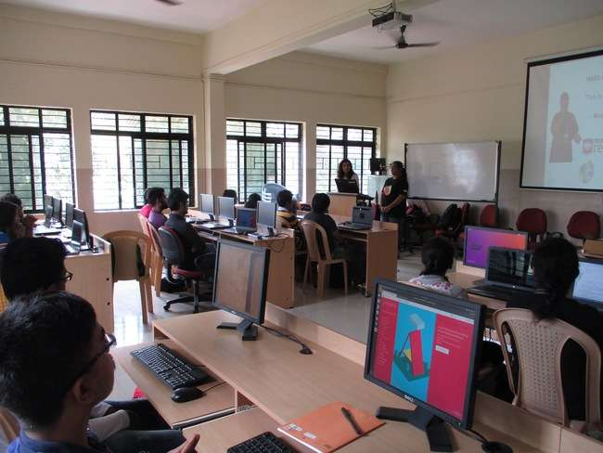
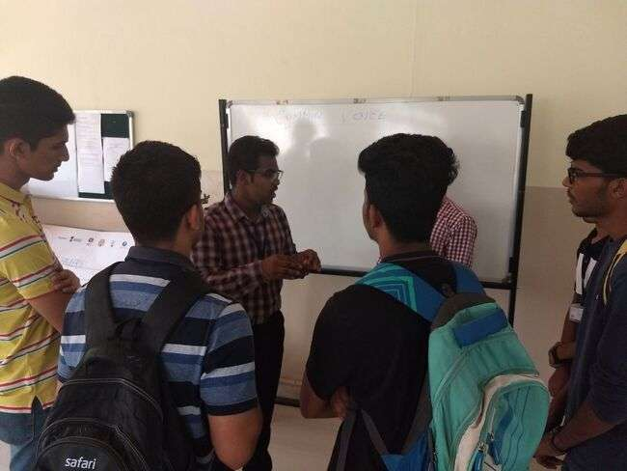
WebVR workshop
Common Voice Sprint

Slide 16
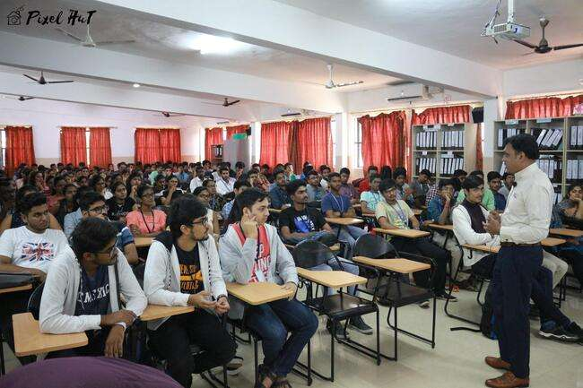
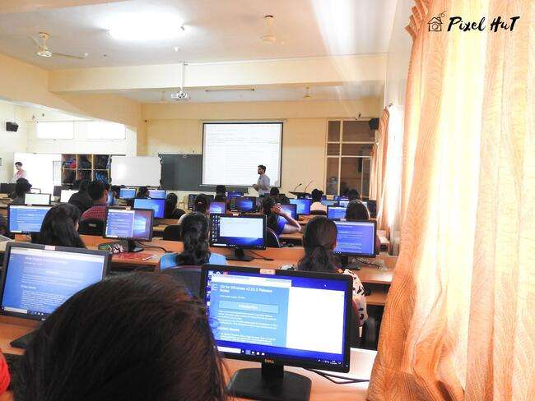
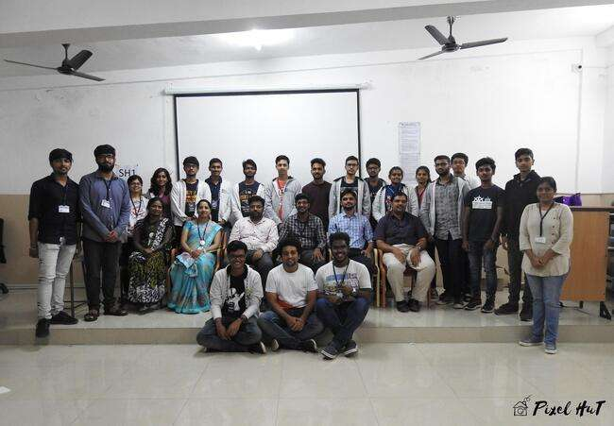
Open Source Day
Notes:
I can go on n on telling u abt wt v r...but our motive is to promote open source

Slide 17
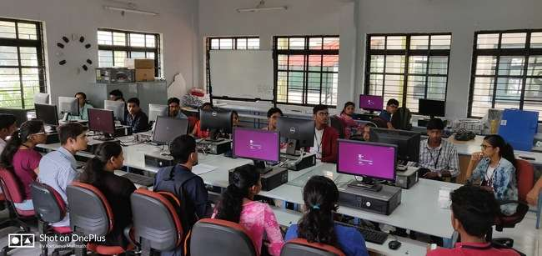
Open Source Day

Slide 18
Upcoming Events
Open Source Day - 2022
Google Summer of Code 2022
Hack-on-Load 3.0
Hacktoberfest
Open Source India
Capture The Flag Tournament
Smart India Hackathon
Hackrupt - 2.0
Open Source Saturdays
Notes:
> Overview:
> Hackathons - National level
> > International conferences
>> TPresent alks and demos
> > Conduct workshops
> > Contribute to open source projects.
Description:
Induction - Hands-on workshop for Freshers
MozFest - Mozilla festival - International conference on Internet Health - Presented a talk+demo
SIH - Smart India Hackathon - World’s largest Hackathon - By Innovation cell of Ministry of Human Resources and Development
DevConf - Attended Developer Conference by RedHat India and built network
Silicon RD Hackathon - National Hackathon - Silicon RD Incubation labs
Hacktoberfest - Month long open source contribution sprint and 20 mini workshops conducted
MLH local hack day - Worldwide decentralized hackathons
Common Voice Sprint - week long contribution sprint - Mozilla Deep speech project
OSI Conference - Open Source India Conference - Promoted Thinger IO development platform(Spanish company product)
WebVR Workshop - Mozilla A-Frame workshop by International speaker
GSoC - Google Summer of Code 2019 - Worldwide open source contribution programme by Google

Slide 19

Benefits
Notes:
So you might be wondering what are the benefits of joining Open Source Lab

Slide 20




Lecturers
Industry Experts
To Monitor progress and provide relevant inputs.
Consulting relevant domain experts in case of roadblocks.
Alumni
Peer
Alumni volunteers share knowledge and support.
Peer review and peer learning.
Notes:
>Guidance/ Mentoring
Provided by:
Lecturers( day-to-day )
Alumni ( Online / Workshops )
Peer ( day-to-day )
Industry experts ( Workshops/Online)increases the breadth of knowledge and sharing information across domains.

Slide 21

Projects
&
Domains
Notes:
Now you guys might wonder we work in Open Source “Lab”, what all experiments and projects have been created and are currently running. Let’s dive into some of them.

Slide 22
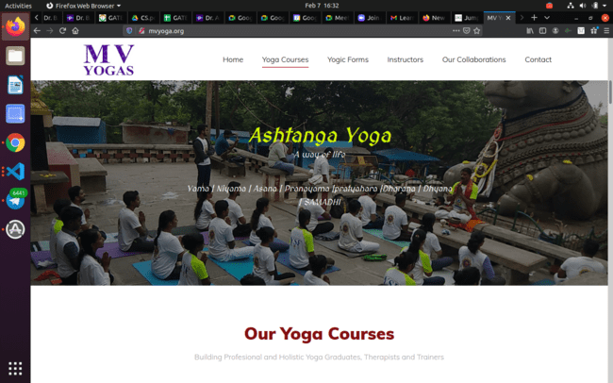
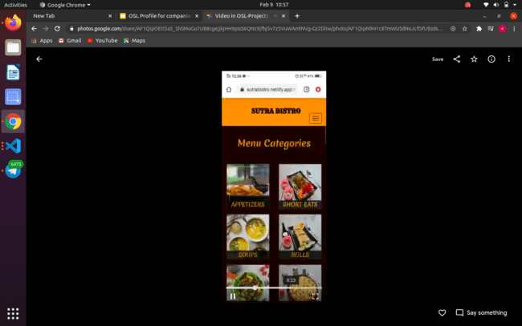
Client: MV Yoga
Client: Sutra Bistro

Slide 23
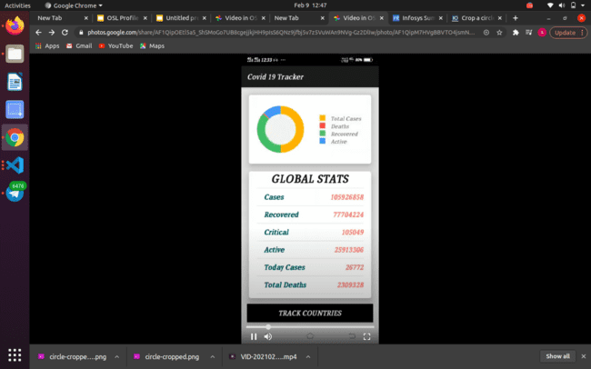
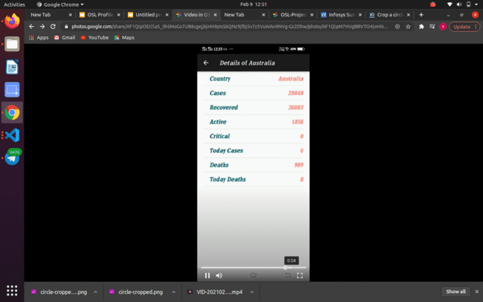
Android App

Slide 24
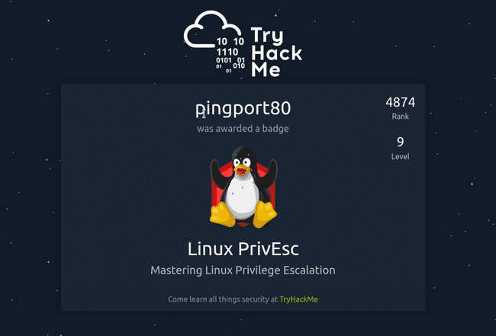
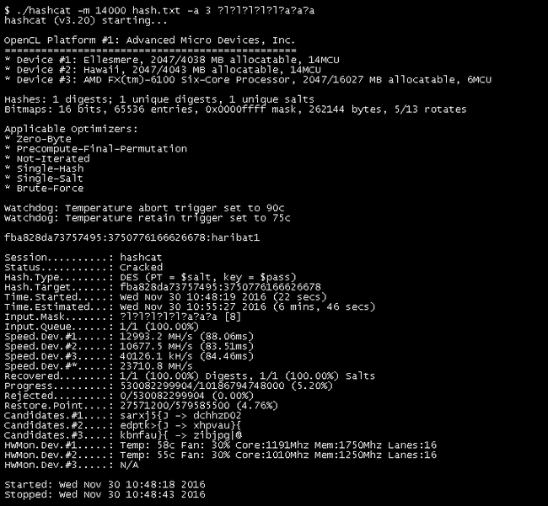
Ethical Hacking

Slide 25
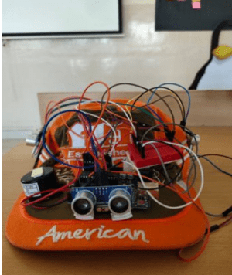
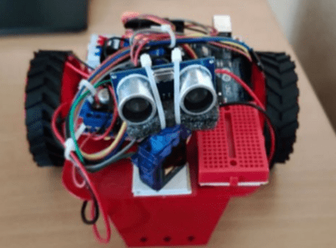
Obstacle Avoiding Bot
Blinds Guide

Slide 26
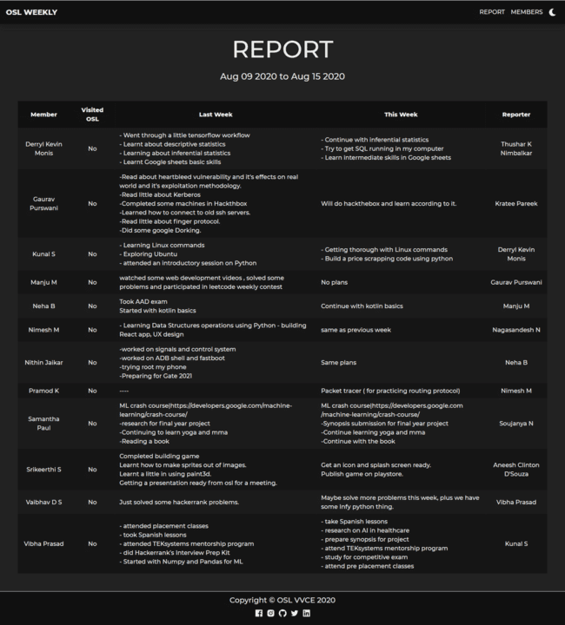
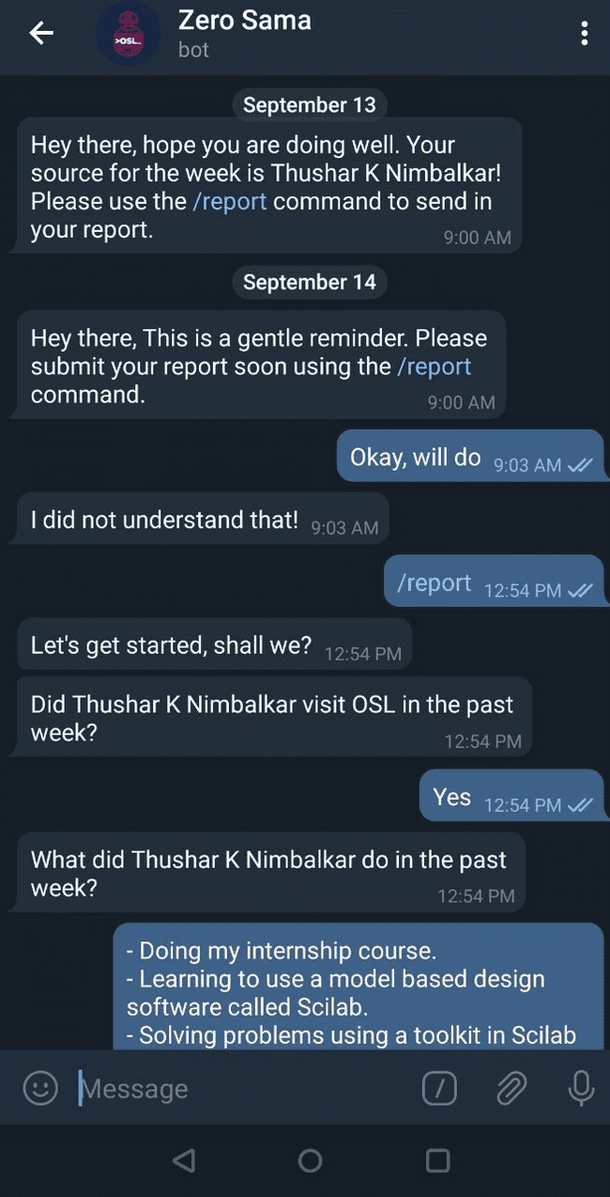
OSL Weekly Report System

Slide 27
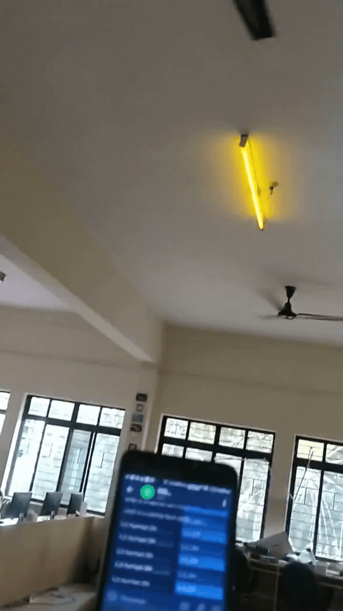
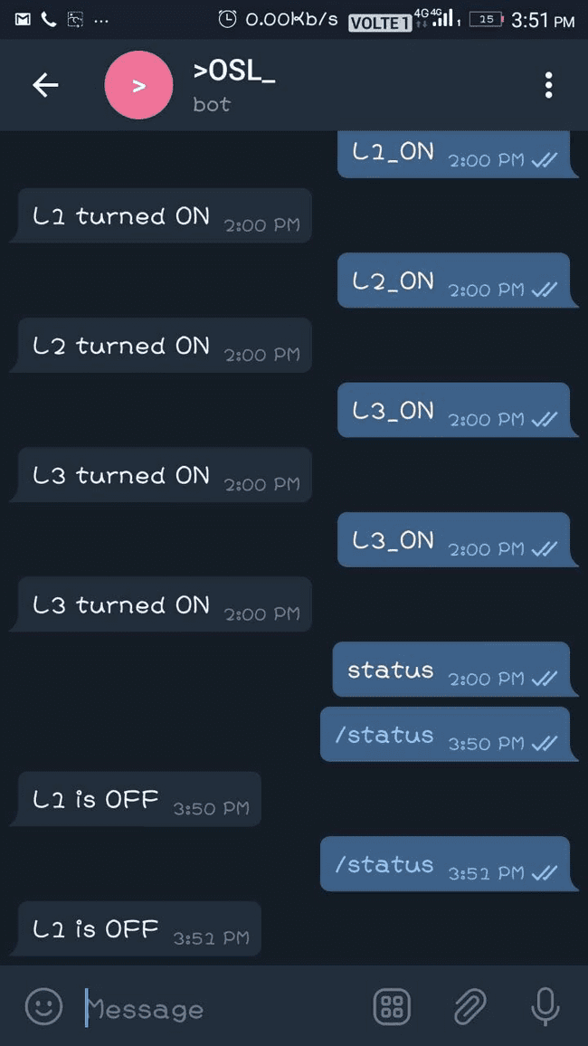
Smart Control using Telegram bot

Slide 28
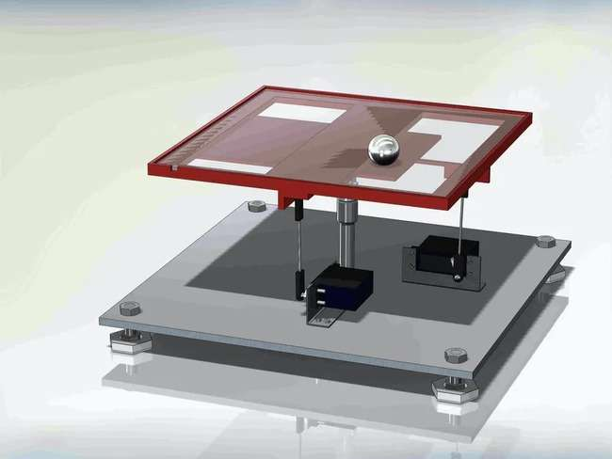
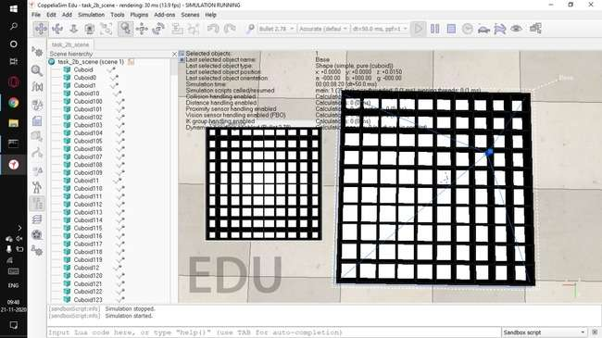
Ball-Balancing Platform & Maze Encoding

Slide 29
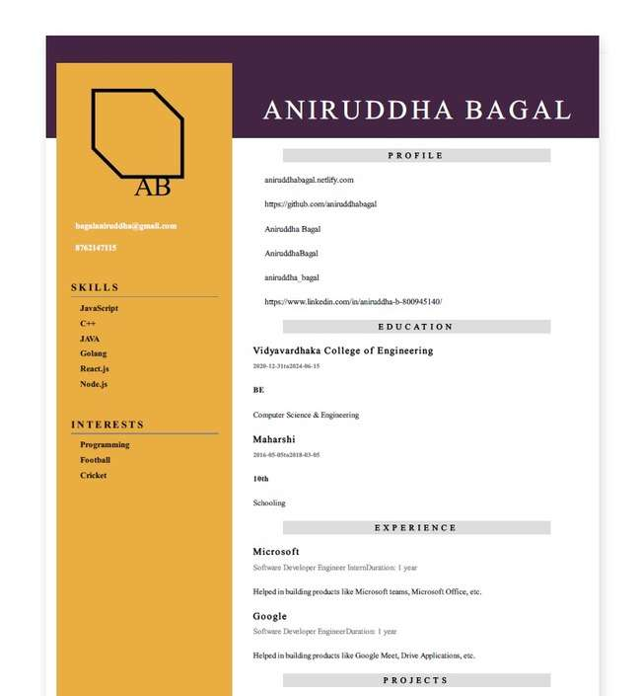
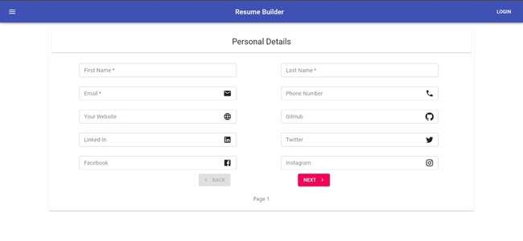
Resume Builder

Slide 30
Projects/ research on Networks
Subnetting and building networks in public networks and private network
File transfer server console.
Experiments on VPN, proxychains, port forwarding.
Evil twin attacks over gateways
Notes:
> Overview:
> Hackathons - National level
> > International conferences
>> TPresent alks and demos
> > Conduct workshops
> > Contribute to open source projects.
Description:
Induction - Hands-on workshop for Freshers
MozFest - Mozilla festival - International conference on Internet Health - Presented a talk+demo
SIH - Smart India Hackathon - World’s largest Hackathon - By Innovation cell of Ministry of Human Resources and Development
DevConf - Attended Developer Conference by RedHat India and built network
Silicon RD Hackathon - National Hackathon - Silicon RD Incubation labs
Hacktoberfest - Month long open source contribution sprint and 20 mini workshops conducted
MLH local hack day - Worldwide decentralized hackathons
Common Voice Sprint - week long contribution sprint - Mozilla Deep speech project
OSI Conference - Open Source India Conference - Promoted Thinger IO development platform(Spanish company product)
WebVR Workshop - Mozilla A-Frame workshop by International speaker
GSoC - Google Summer of Code 2019 - Worldwide open source contribution programme by Google

Slide 31
On-going projects
Dynamic QR Code [Open Sourcing]
Resume builder 1.0
Lever counter for X-ray scanner - Skanray consultancies
Research on thread coding of OS
Improving Python Meterpreter - MetaSploit
Improving Sugar Activities - Sugarlabs
Notes:
> Overview:
> Hackathons - National level
> > International conferences
>> TPresent alks and demos
> > Conduct workshops
> > Contribute to open source projects.
Description:
Induction - Hands-on workshop for Freshers
MozFest - Mozilla festival - International conference on Internet Health - Presented a talk+demo
SIH - Smart India Hackathon - World’s largest Hackathon - By Innovation cell of Ministry of Human Resources and Development
DevConf - Attended Developer Conference by RedHat India and built network
Silicon RD Hackathon - National Hackathon - Silicon RD Incubation labs
Hacktoberfest - Month long open source contribution sprint and 20 mini workshops conducted
MLH local hack day - Worldwide decentralized hackathons
Common Voice Sprint - week long contribution sprint - Mozilla Deep speech project
OSI Conference - Open Source India Conference - Promoted Thinger IO development platform(Spanish company product)
WebVR Workshop - Mozilla A-Frame workshop by International speaker
GSoC - Google Summer of Code 2019 - Worldwide open source contribution programme by Google

Slide 32
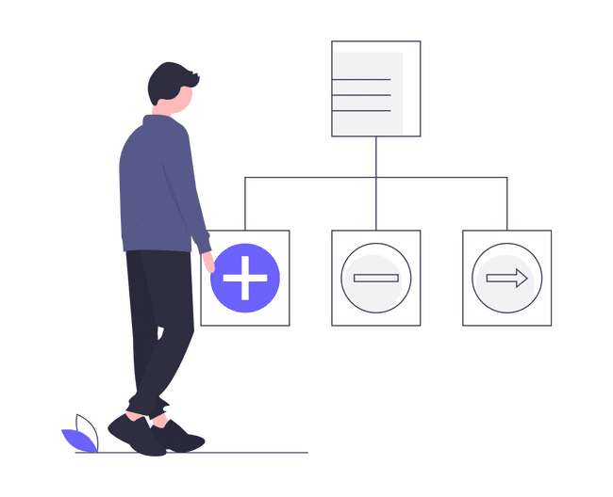

Key Priorities
Learn the ethics and functioning of an organization
Get more members in participating and contributing via GSOC.
Get more teams into Hackathons.
Members to be recruited into open source organizations
Deliverables
Conduct events and workshops
Promote Open Source Development and contribute to company repos.
Create industry ready projects that benefit society.

Slide 33
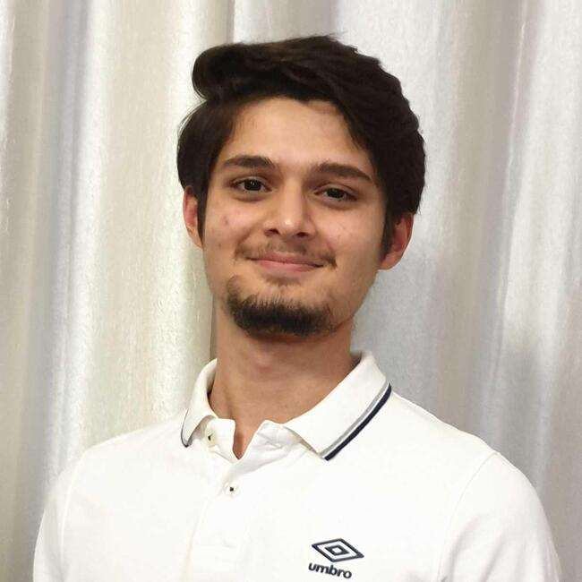

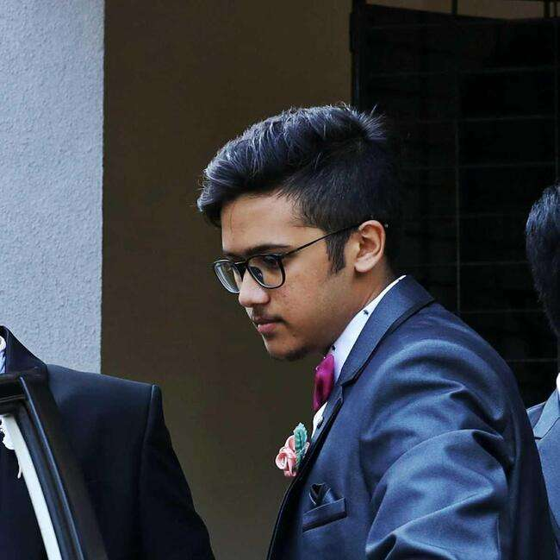

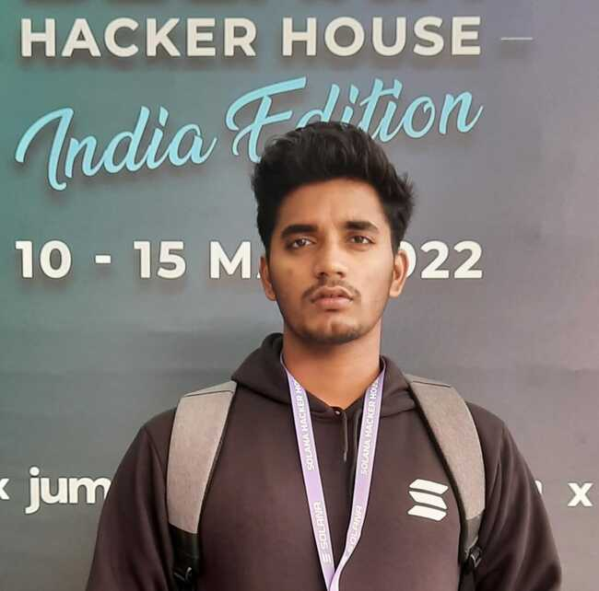
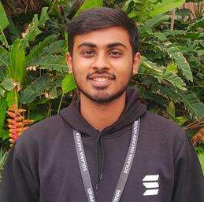
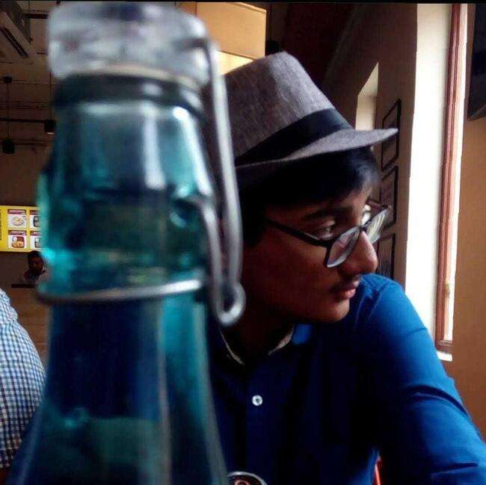
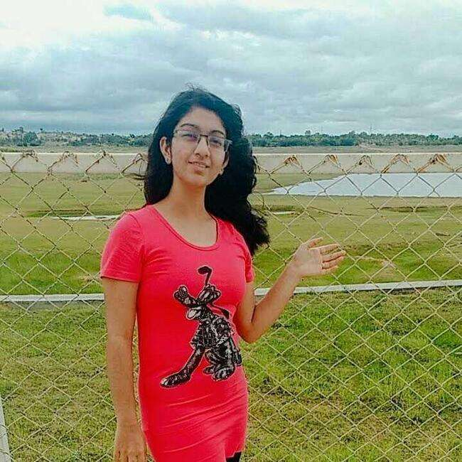
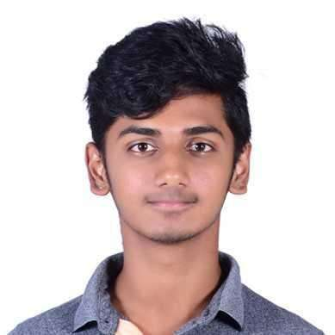
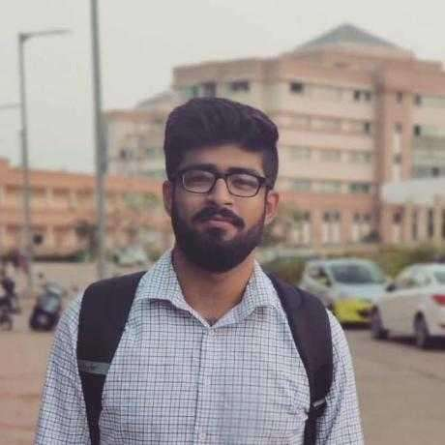
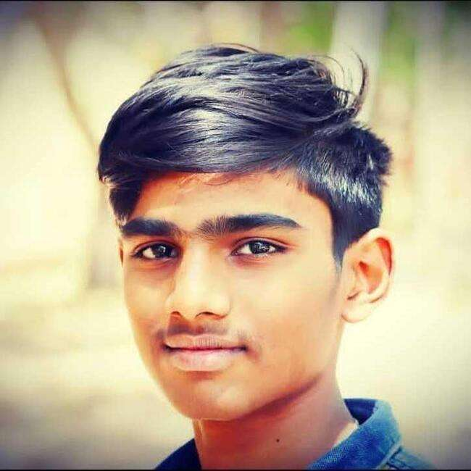
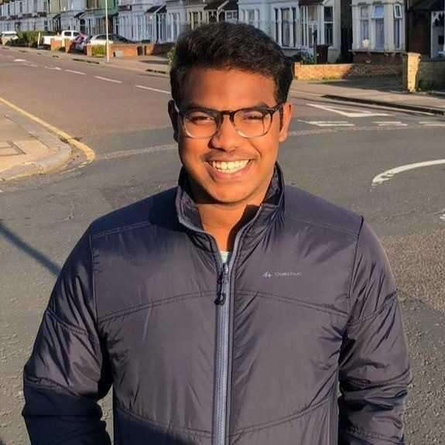








The Team
Notes:
> Community of Students and Teachers
> Enthusiasts who promote Open Source Technologies
> Learning done by Contribution
> Socializing with Co-Enthusiasts on same path
> A part of a huge global network of developers

Slide 34








Alumni
Madhurish Katta
Harsha Srinivas
Rahul
Shreevari S P
Deep Learning,
TensorFlow,
Artificial Neural Network
Machine Learning,
Arduino,
Convolutional Neural Network
Arduino,
NodeMCU,
C, C++,
Python
Image processing, docker,
X86, C, C++, python, rust,
Rajkumar Jain
Pavan Kirigeri
Darshan
Ashwin A Kumar
UI/UX Developer,
React.js,
Redux.js
Django,
PHP,
Angular.js
Full Stack Web Developer,
React Native
Full Stack Web Developer,
React Native
Notes:
Amazing Alumni’s who began Open Source Lab

Slide 35

How to join OSL?
Notes:
Procedure to join OSL
Step1: Meet the students. (Contact info in next slide)
Step2: Task will be provided with link.
Step3: Completion of task will provide entry access to OSL
Step4: Special OSL merch for students completing many tasks

Slide 36


Contact us
Visit: oslvvce.com
Mail: osl@vvce.ac.in
Telegram: t.me/oslvvce
Notes:
Anyone interested can meet OSL members at Open Source Lab and they will guide you on what are the things you must do to join OSL.

